Slide 1
Intellectual Property Protection Platform based on Ethereum Blockchain
Presented by
Group 9 Fall 2023
Soomin Im Joyanta Mondal Kaine Hines Rajendra Mohan Alexus Brown

Slide 2

Overview
In an era where creativity drives industries, safeguarding intellectual property is more crucial than ever. From inventions to artistic works, intellectual property fuels innovation. However, challenges like piracy demand innovative solutions. Our Distributed App (DApp), leveraging blockchain, provides a secure and decentralized space to protect and manage intellectual property rights.
CS6-746 - Blockchain and Cryptography
Group 9

Slide 3
Objective and Overview of The Project
We develop a robust and secure Ethereum blockchain-based app for efficient management and protection of intellectual property.
Users can register and retrieve their intellectual properties.
We use Ethereum, Solidity, Web3.js, MetaMask, Pinata Cloud, and Remix for this app.
CS6-746 - Blockchain and Cryptography
Group 9

Slide 4
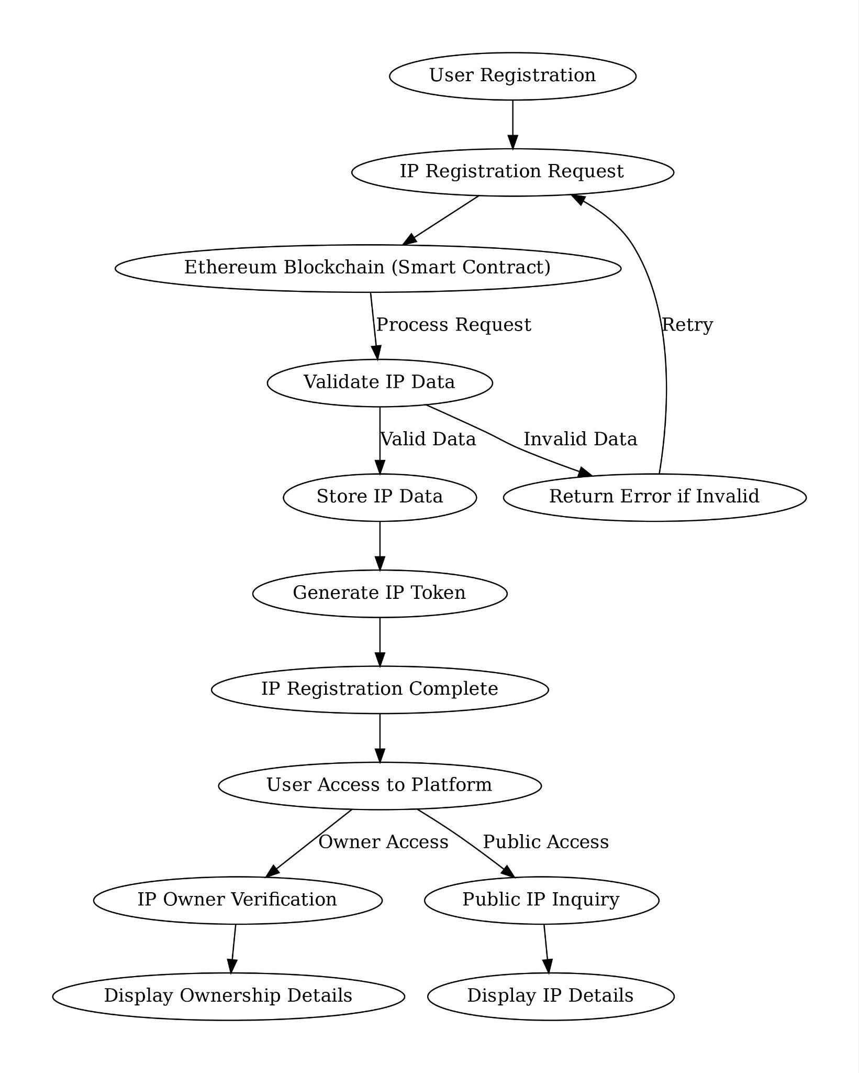
Architecture and Design Principles
Ethereum Blockchain having the smart contracts. (NFT.sol)
The Blockchain is connected to a front-end built with html, CSS and the JavaScript package of web3.
Properties are saved through another cloud server named Pinata Cloud.
Process of NFTs:
Create your art or other unique digital assets. The first step in creating an NFT is to choose what content you want to turn into an NFT.
Choose a blockchain and set up a wallet.
Upload your NFT to a marketplace and add details.
Fig: Process Flow
CS6-746 - Blockchain and Cryptography
Group 9

Slide 5
Commands
We run the following commands:
npm install -g @remix-project/remixd; to install allows a websocket connection between Remix IDE (web application) and the local computer.
npm install web3 ; to install web3
Then in terminal, we go to the project directory and type “remixd” command to get started to Remix IDE.
Connect the Localhost in the IDE.
Then we connect to our MetaMask to get an address to sync up to our wallet.
CS6-746 - Blockchain and Cryptography
Group 9

Slide 6
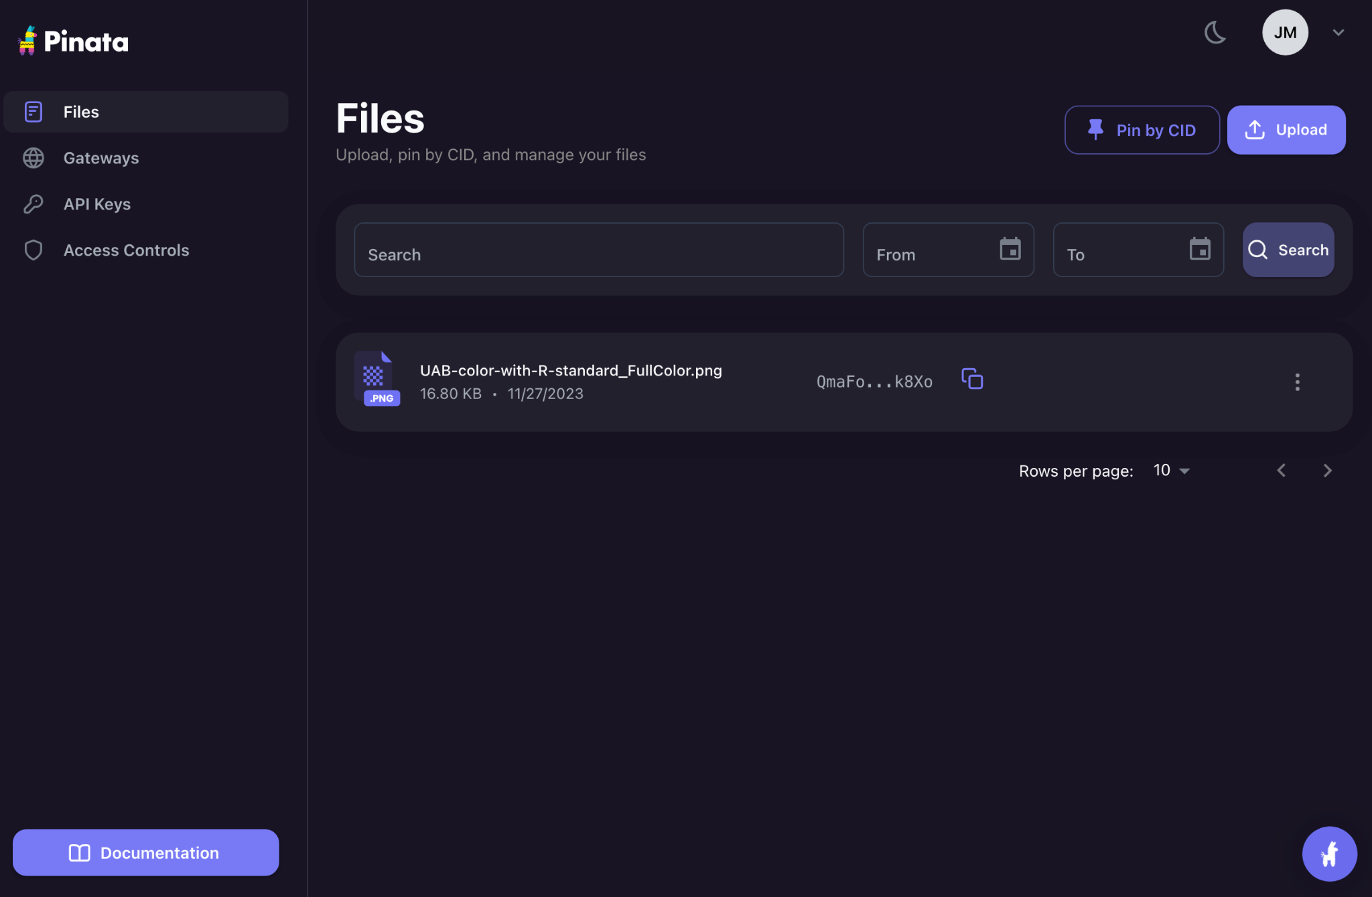
Continued…
Side by side, initially, as a user, we need to register on Pinata and upload the property in the server.
Then it will get a ID against the image. For instance, for the image here uploaded, the ID is QmaFo….k8Xo.
We need to take the ID and then proceed to mint.
CS6-746 - Blockchain and Cryptography
Group 9

Slide 7
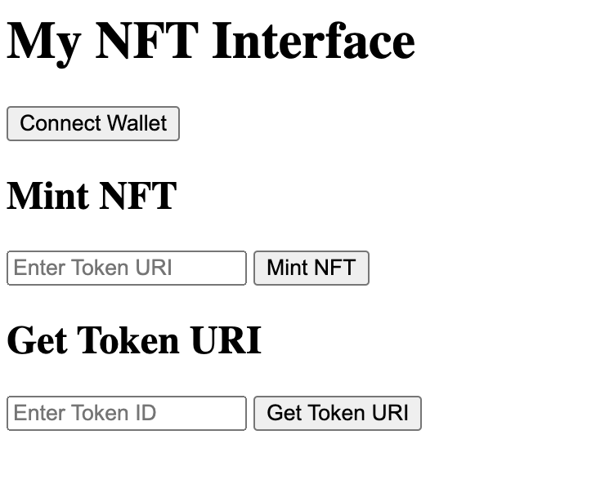
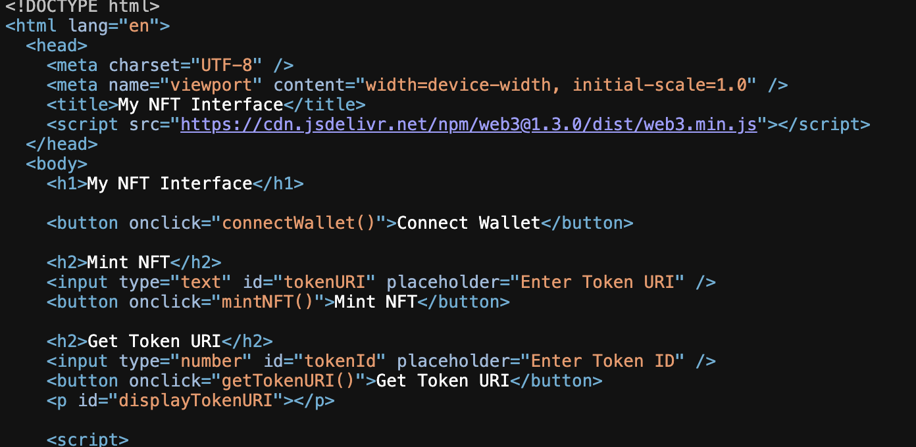
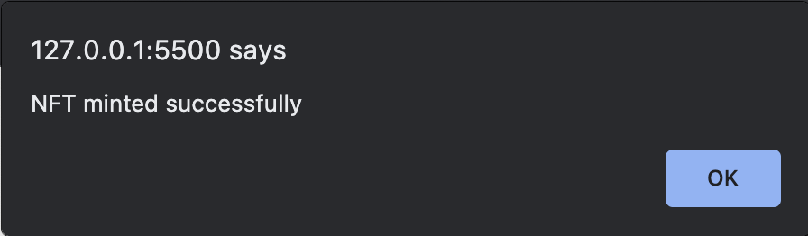
Continued…
This is the frontend user interface and the file where we register the IP.
We initially connect the wallet hitting the button.
*To connect the wallet, it needs to be ensured that the contract ABI and address (from Remix IDE after compiling the .sol file) is correct.
To mint the property, we need to enter the token URL which has a common front part of “https://gateway.pinata.cloud/ipfs/”
**For our example, sample is “https://gateway.pinata.cloud/ipfs/QmaFo….k8Xo”
After minting the property, we get this.
CS6-746 - Blockchain and Cryptography
Group 9

Slide 8
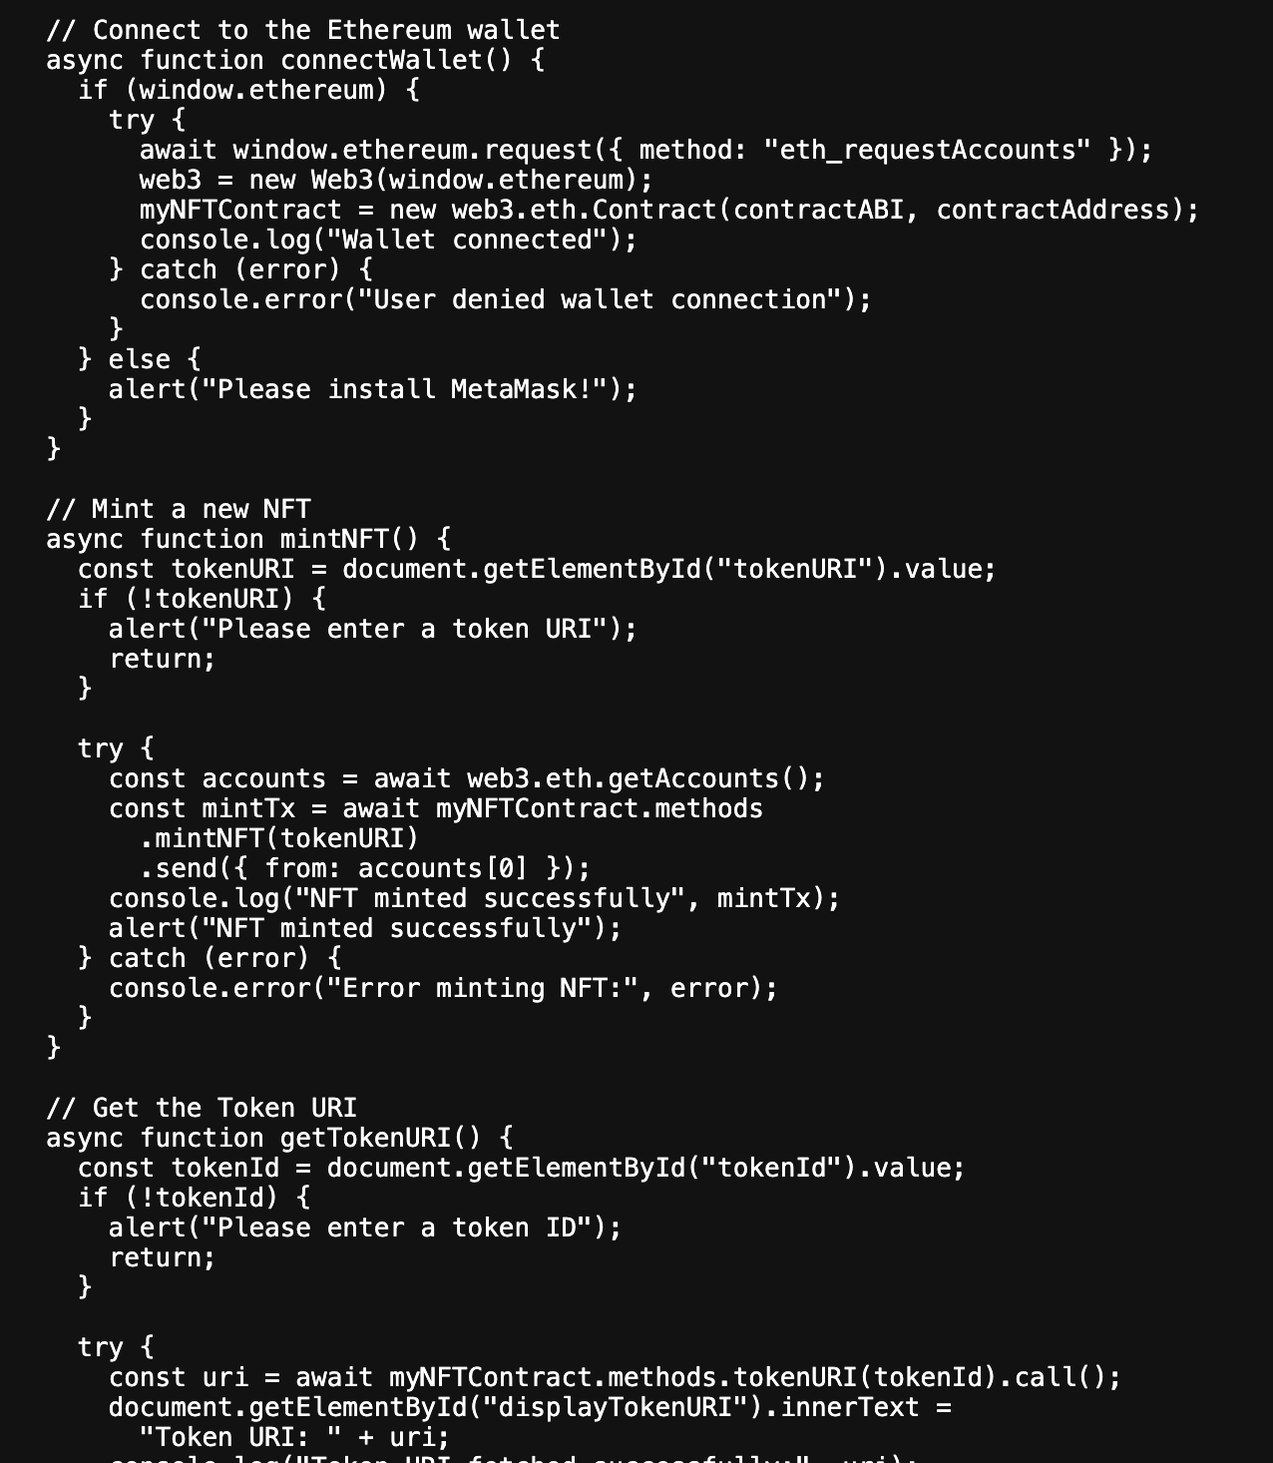
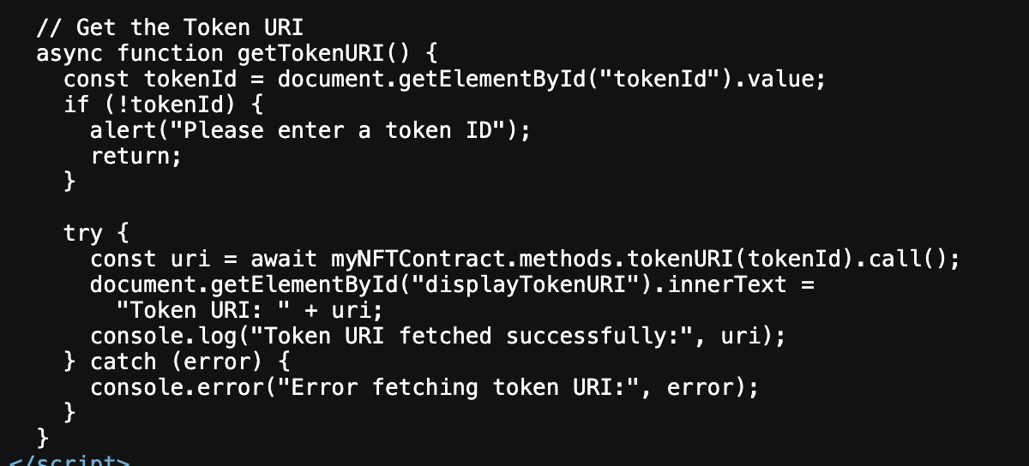
Continued…
This is the web3 js file (combined with html) where we have a structure of a IP.
In the mintNFT(); we mint a new property.
In the getTokenURI; we get the token URI, the link to the property where it is stored.
CS6-746 - Blockchain and Cryptography
Group 9

Slide 9
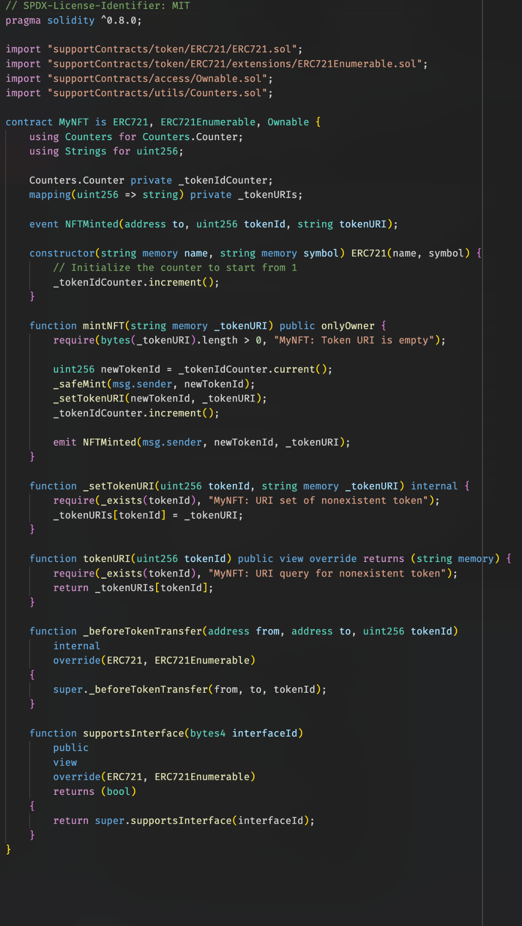
Continued…
This is NFT.sol file where we initialize the tokens using ERC721.
We initialize with tokenIDCounter and tokenURIs.
Then there is mintNFT function that mints the property.
After that, there is two functions for token URI which sets the token URI and works on it.
CS6-746 - Blockchain and Cryptography
Group 9

Slide 10
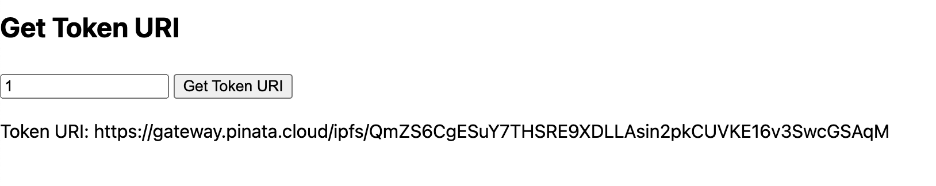
Continued…
When someone wants to get the Token URI, they need to put the token number. After that, they can easily retrieve the token.
CS6-746 - Blockchain and Cryptography
Group 9

Slide 11
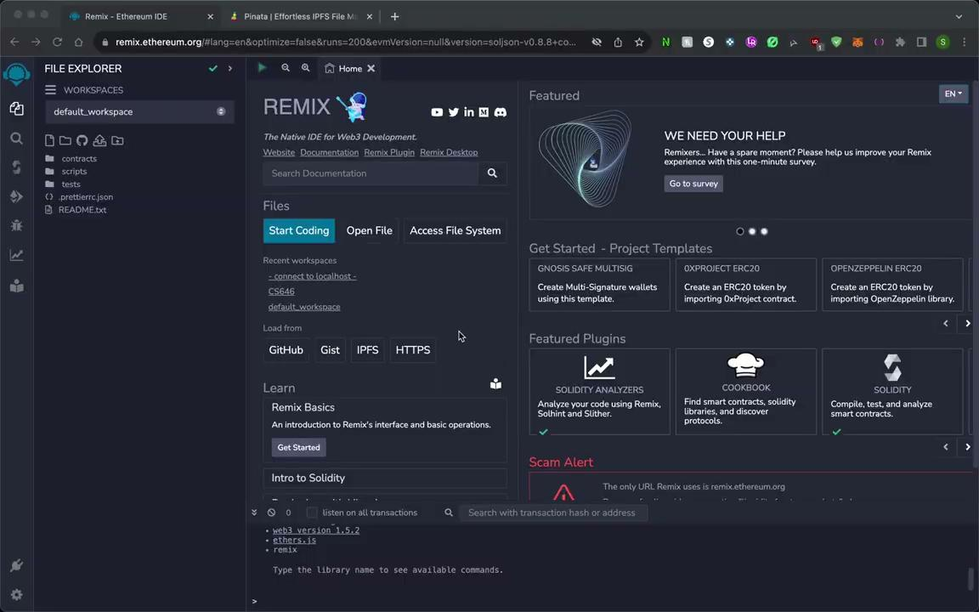
Live Demo of The Project
*Zoom or this video*
CS6-746 - Blockchain and Cryptography
Group 9

Slide 12
Limitations and Future Improvements
Limitations:
It is a basic app, just to have the initial idea of how a DApp works.
Needs more exploration to identify if any new property which is trying to get registered is same to any previously registered property.
There is a potential of the app facing a regulatory and legal challenge, considering the regulatory landscape related to blockchain technology.
Future Improvements:
Deploying on a real domain to work on preserving IP on private database and server.
Developing more user-friendly interfaces to simplify interaction with the platform for non-technical users.
CS6-746 - Blockchain and Cryptography
Group 9

Slide 13
Lessons Learned
Using Solidity to write smart contract
Using the Web3 package of JS
Using node package to run Web3
Using MetaMask for using Ethereum TestNet
Using Remix IDE
Using Pinata Cloud to use as a database.
CS6-746 - Blockchain and Cryptography
Group 9

Slide 14
Thank You!
Any Questions?

Slide 15
Objective
We develop a robust and secure Ethereum blockchain-based platform for efficient management and protection of intellectual property.
Decentralization
Security Enhancement
Transparency Objective
Efficient IP Management
User Empowerment
Scalability
CS6-746 - Blockchain and Cryptography
Group 9

Slide 16
Ethereum
A decentralized platform that enables the creation and execution of smart contracts and decentralized applications (DApps) without downtime, fraud, control, or interference from a third party.
Utilizes blockchain technology.
Allows for the development of smart contracts, self-executing contracts with the terms of the agreement directly written into code.
Supports Turing-complete programming languages like Solidity, enabling developers to create a wide range of applications.
Implements a gas system to allocate resources on the network, where transactions require a fee.
Used for a variety of applications, including decentralized finance (DeFi), gaming, and more.
CS6-746 - Blockchain and Cryptography
Group 9

Slide 17
Smart Contract
Digital agreements for blockchain execution, directly written into lines of code.
Automatically execute and enforce the terms of a contract when predefined conditions are met, without the need for intermediaries.
Can be programmed for a wide range of applications, from simple transactions to complex decentralized applications.
Minimizes the risk of fraud and reduces the costs associated with traditional contracts.
Ensures transparency, as the contract terms are visible and verifiable by all parties involved.
CS6-746 - Blockchain and Cryptography
Group 9

Slide 18
Solidity
A high-level programming language designed for developing smart contracts on the Ethereum blockchain.
An object-oriented language, enabling developers to create contracts for voting, crowdfunding, blind auctions, multi-signature wallets, and more.
Its syntax is similar to that of JavaScript, C++, and Python, making it relatively easy for developers from these languages to learn.
Used to write and implement smart contracts that can automatically enforce and execute the terms of an agreement.
Solidity programs are compiled into bytecode, which is executed on the Ethereum Virtual Machine.
CS6-746 - Blockchain and Cryptography
Group 9

